Slide 1
CASE STUDY -1 DANNY’S DINER
Source: https://8weeksqlchallenge.com/case-study-1/

Slide 2

DATA SOURCE
Please note that the case study information provided below has been sourced from the following link: https://8weeksqlchallenge.com/case-study-1/

Slide 3
INTRODUCTION
Danny seriously loves Japanese food so in the beginning of 2021, he decides to embark upon a risky venture and opens up a cute little restaurant that sells his 3 favorite foods: sushi, curry and ramen.
Danny’s Diner is in need of assistance to help the restaurant stay afloat — the restaurant has captured some very basic data from their few months of operation but have no idea how to use their data to help them run the business.

Slide 4
PROBLEM STATEMENT
Danny wants to use the data to answer a few simple questions about his customers, especially about their visiting patterns, how much money they’ve spent, and which menu items are their favorite.
Having this deeper connection with his customers will help him deliver a better and more personalized experience for his loyal customers.
He plans on using these insights to help him decide whether he should expand the existing customer loyalty program — additionally he needs help to generate some basic datasets so his team can easily inspect the data without needing to use SQL.

Slide 5
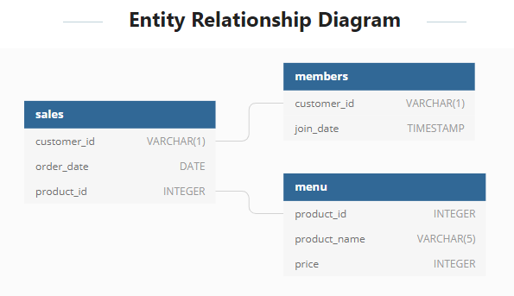
TABLES AND ITS RELATIONSHIPS
The data set contains the following 3 tables:
Members
Menu
Sales

Slide 6
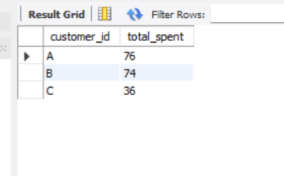
QUESTIONS AND SOLUTIONS
I am utilizing MySQL Workbench to solve these questions.
1. What is the total amount each customer spent at the restaurant?
SELECT s.customer_id, SUM(m.price) AS total_spent
FROM sales s
JOIN menu m
ON s.product_id = m.product_id
GROUP BY s.customer_id;
Solution: Customer A spent $76.
Customer B spent $74.
Customer C spent $36.

Slide 7
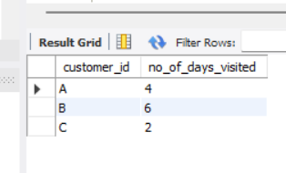
2. How many days has each customer visited the restaurant?
SELECT customer_id,
COUNT(DISTINCT order_date) AS no_of_days_visited
FROM sales
GROUP BY customer_id;
Solution: Customer A visited 4 times.
Customer B visited 6 times.
Customer C visited 2 times.

Slide 8
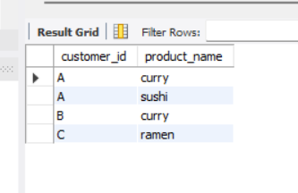
3. What was the first item from the menu purchased by each customer?
WITH cte AS (
SELECT s.*, m.product_name,
DENSE_RANK() OVER(PARTITION BY s.customer_id ORDER BY order_date) AS r1
FROM sales s
JOIN menu m
ON s.product_id = m.product_id
)
SELECT customer_id, product_name
FROM cte
WHERE r1 = 1
GROUP BY customer_id, product_name
ORDER BY customer_id, product_name;
Solution:
Customer A’s first order are curry and sushi.
Customer B’s first order is curry.
Customer C’s first order is ramen.

Slide 9
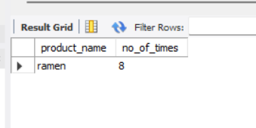
4. What is the most purchased item on the menu and how many
times was it purchased by all customers?
SELECT m.product_name, COUNT(s.customer_id) AS no_of_times
FROM sales s
JOIN menu m
ON s.product_id = m.product_id
GROUP BY m.product_name
ORDER BY no_of_times DESC
LIMIT 1;
Solution:
The most purchased item on the menu is ramen which is 8 times.

Slide 10
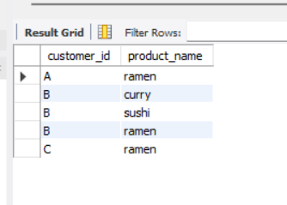
5. Which item was the most popular for each customer?
WITH cte AS (
SELECT customer_id, product_name, COUNT(*) AS ordered_times
FROM salesmenu
GROUP BY customer_id, product_name
),
cte2 AS (
SELECT *,
DENSE_RANK() OVER(PARTITION BY customer_id ORDER BY ordered_times DESC) AS rank1
FROM cte
)
SELECT customer_id, product_name
FROM cte2
WHERE rank1 = 1;
Solution: Each user may have more than 1 favorite item.
Answer:
Customer A and C’s favorite item is ramen.
Customer B enjoys all items on the menu. He/she is a true foodie.

Slide 11
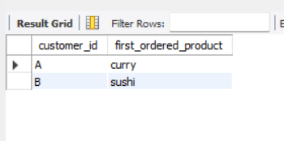
6. Which item was purchased first by the customer after they became a member?
WITH cte AS (
SELECT s.customer_id, m2.product_name, s.order_date
FROM sales s
JOIN members m
ON s.customer_id = m.customer_id
JOIN menu m2
ON s.product_id = m2.product_id
WHERE s.order_date >= m.join_date
),
cte2 AS (
SELECT *,
RANK() OVER(PARTITION BY customer_id ORDER BY order_date) AS r1
FROM cte
)
SELECT customer_id, product_name AS first_ordered_product
FROM cte2
WHERE r1 =1;
Solution: Customer A’s first order as a member is ramen.
Customer B’s first order as a member is sushi.

Slide 12
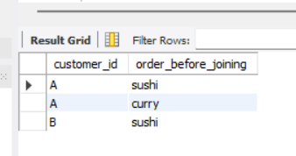
7. Which item was purchased just before the customer became a member?
WITH cte AS (
SELECT s.customer_id, s.order_date, m2.product_name
FROM sales s
JOIN members m
ON s.customer_id = m.customer_id
JOIN menu m2
ON s.product_id = m2.product_id
WHERE order_date < join_date
),
cte2 AS (
SELECT *,
RANK() OVER(PARTITION BY customer_id ORDER BY order_date DESC) AS R1
FROM cte
)
SELECT customer_id, product_name AS order_before_joining
FROM cte2
WHERE R1=1;
Solution:
A’s last order is Curry and Sushi.
Both customers common last order before becoming members are sushi. That must have been a really good sushi.

Slide 13
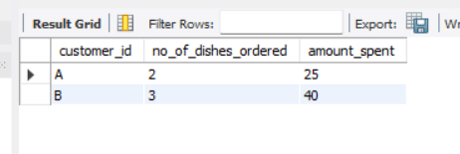
8. What is the total items and amount spent for each member
before they became a member?
WITH cte AS (
SELECT s.customer_id, s.order_date, m2.product_name, m2.price
FROM sales s
JOIN members m
ON s.customer_id = m.customer_id
JOIN menu m2
ON s.product_id = m2.product_id
WHERE order_date < join_date
)
SELECT customer_id, COUNT(*) AS no_of_dishes_ordered, SUM(price) AS amount_spent
FROM cte
GROUP BY customer_id;
Solution:
Before becoming members,
Customer A spent $25 on 2 items.
Customer B spent $40 on 3 items.

Slide 14
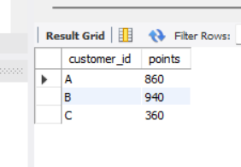
9. If each $1 spent equates to 10 points and sushi has a 2x points multiplier - how many points would each customer have?
SELECT customer_id,
SUM(CASE
WHEN product_name = "sushi" THEN price*20
ELSE price * 10
END) AS points
FROM salesmenu
GROUP BY customer_id;
Solution:
The total points for Customers A, B and C are $860, $940 and $360.

Slide 15
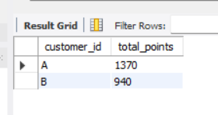
10. In the first week after a customer joins the program (including their join date) they earn 2x points on all items, # not just sushi - how many points do customer A and B have at the end of January?
WITH cte AS (
SELECT s.*, m.join_date
FROM salesmenu s
JOIN members m
ON s.customer_id = m.customer_id
),
cte2 AS (
SELECT customer_id,
SUM(CASE
WHEN product_name = "sushi" THEN price*20
ELSE price * 10
END) AS before_joining_points
FROM cte
WHERE order_date < join_date
GROUP BY customer_id
),
cte3 AS (
SELECT customer_id,
SUM(price * 20) AS after_joining_points
FROM cte
WHERE order_date >= join_date
AND order_date < '2021-02-01'
GROUP BY customer_id
)
SELECT c2.customer_id, before_joining_points + after_joining_points AS total_points
FROM cte2 c2
JOIN cte3 c3
ON c2.customer_id = c3.customer_id;
Solution:
Customer A has 1,370 points.
Customer B has 940 points.

Slide 16
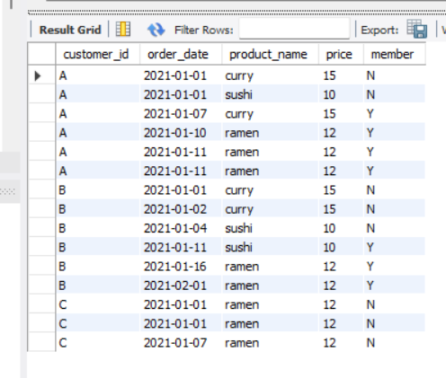
BONUS QUESTIONS
The following questions are related creating basic data tables that Danny and his team can use to quickly derive insights without needing to join the underlying tables using SQL.
1. Recreate the following table output using the available data:
CREATE TABLE customerinfo AS
SELECT s.customer_id, s.order_date, m.product_name, m.price,
CASE
WHEN m2.join_date IS NULL THEN 'N'
WHEN s.order_date < m2.join_date THEN 'N'
ELSE 'Y'
END AS member
FROM sales s
LEFT JOIN menu m
ON s.product_id = m.product_id
LEFT JOIN members m2
ON s.customer_id = m2.customer_id
ORDER BY s.customer_id, s.order_date, m.product_name;
SELECT * FROM customerinfo;

Slide 17
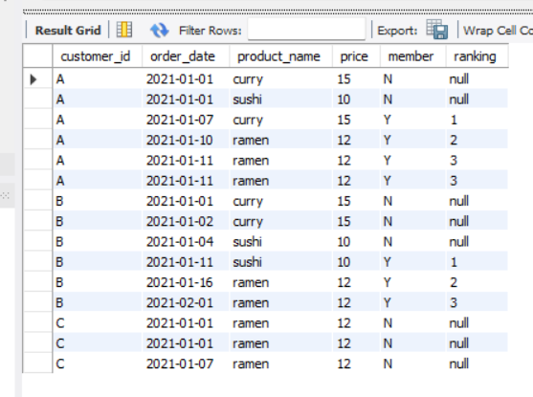
2. Danny also requires further information about the ranking of customer products, but he purposely does not need the ranking for non-member purchases so he expects null ranking values for the records when customers are not yet part of the loyalty program.
SELECT customer_id, order_date, product_name, price, member,
DENSE_RANK() OVER(PARTITION BY customer_id ORDER BY order_date) AS ranking
FROM customerinfo
WHERE member != 'N'
UNION ALL
SELECT customer_id, order_date, product_name, price, member, "null" AS ranking
FROM customerinfo
WHERE member = 'N'
ORDER BY customer_id, order_date

Slide 18
INSIGHTS
From the analysis, we discover a few interesting insights that would be certainly useful for Danny.
Customer B is the most frequent visitor with 6 visits in Jan 2021.
Danny’s Diner’s most popular item is ramen, followed by curry and sushi.
Customer A and C loves ramen whereas Customer B seems to enjoy sushi, curry and ramen equally.
Customer A is the 1st member of Danny’s Diner and his first order is curry. Gotta fulfill his curry cravings!
The last item ordered by Customers A and B before they became members are sushi and curry. Does it mean both of these items are the deciding factor? It must be really delicious for them to sign up as members!
Before they became members, both Customers A and B spent $25 and $40.
Throughout Jan 2021, their points for Customer A: 860, Customer B: 940 and Customer C: 360.
Assuming that members can earn 2x a week from the day they became a member with bonus 2x points for sushi, Customer A has 660 points and Customer B has 340 by the end of Jan 2021.

Slide 19
CONCLUSION
This project was a hands-on learning experience that enhanced my SQL skills and analytical abilities.
I gained proficiency in using SQL to explore and analyse large datasets, extract relevant information, and draw valuable insights.
Links to Project file:
Dataset: https://8weeksqlchallenge.com/case-study-1/
Github Link:

